Slide 1

RAJASTHAN TECHNICAL UNIVERSITY KOTA
SMART IRRIGATION SYSTEM

Slide 2
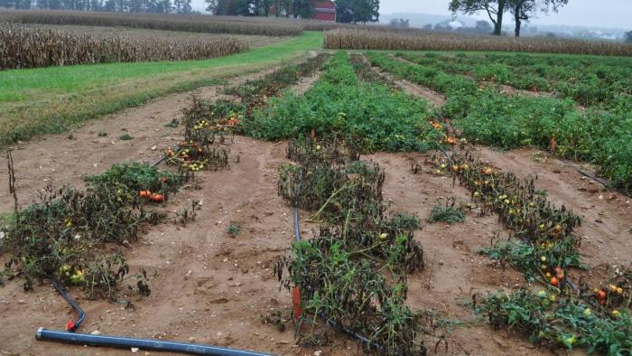
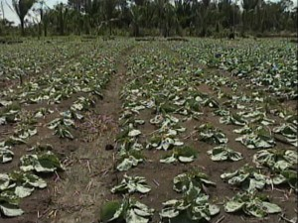
PROBLEM STATEMENT
farmer use traditional method to schedule the irrigation that leads them to loss on yield as proper irrigation is the key for the yield of crop
Crop destroyed due to over and under irrigation

Slide 3
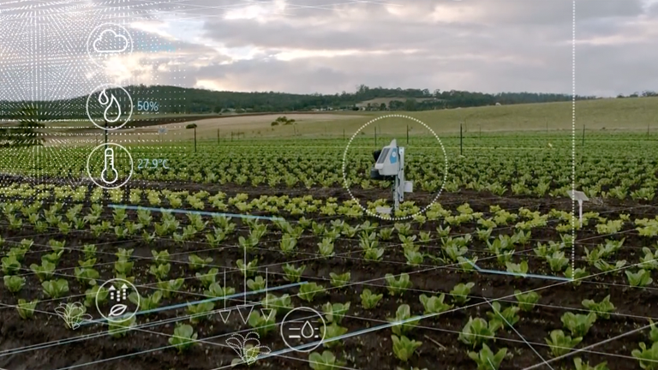
SOLUTION APPROACH
We developed an IOT based solution which informs about when and how much to irrigate ; on the basis of real time data concerned to irrigation of field

Slide 4
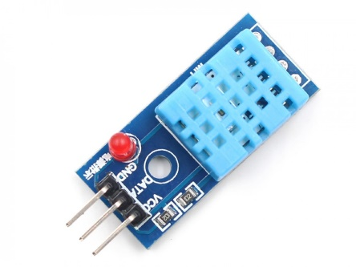
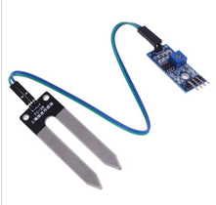
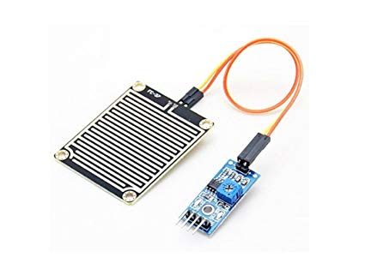
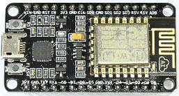
STEPS FOR SOLUTION-
DHT 11
SOIL MOISTURE SENSOR
RAIN INDICATOR
MICRO CONTROLLER
WEB SERVER
DATABASE
IRRIGATION CONCEPT
ANALYSIS
DISPLAY ON WEB DESK BOARD
ALERT SMS ON CELL

Slide 5
CONCEPT OF IRRIGATION
OMC<AMC < FC
Data is analysed using basic formula calculation for irrigation and desired results are obtained. frequency of irrigation= (omc-amc)/per day water consumption (u)
SOURCE:-
NRCCA (NORTHEAST REGION CERTIFIED CROP ADVISER
FAO (www.fao.org)
www.sciencedirect.com
www.Illinois.edu

Slide 6
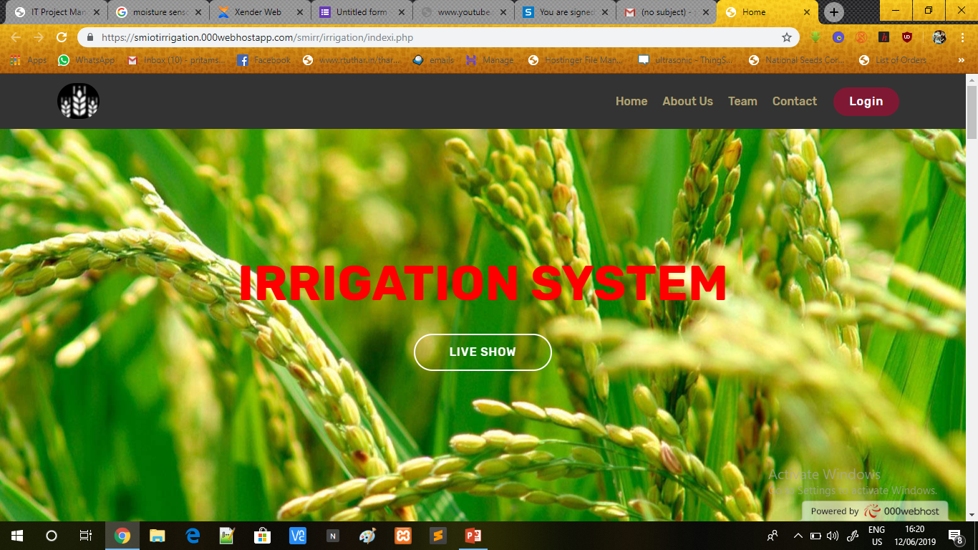
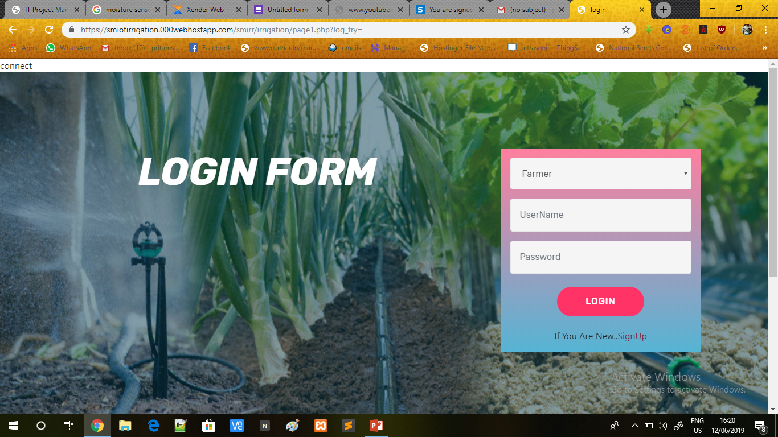
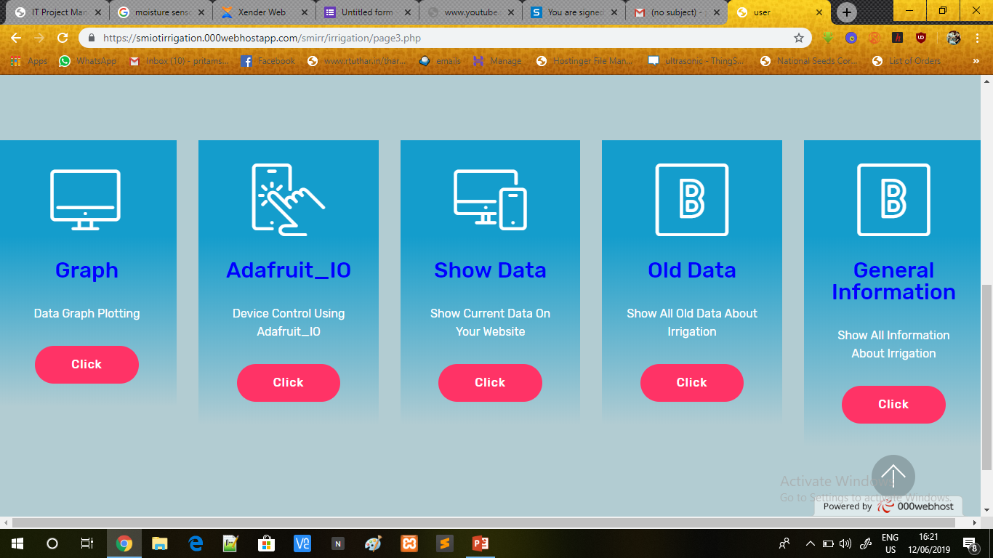

Slide 7
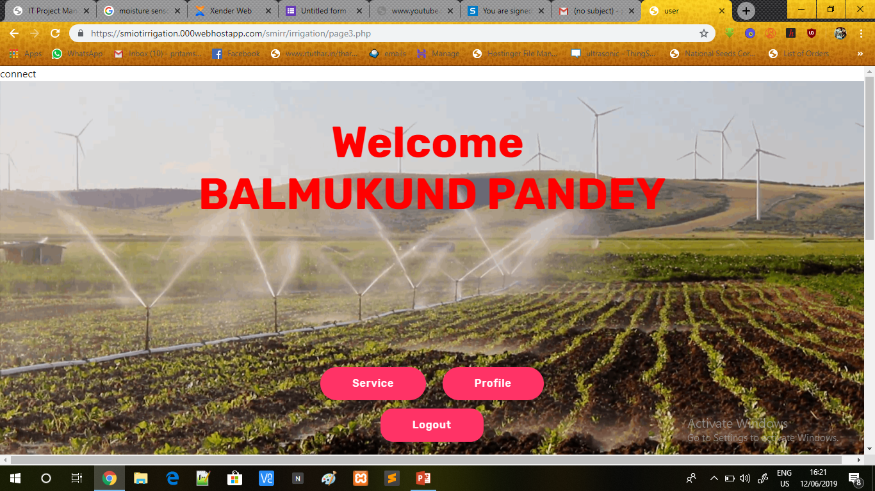
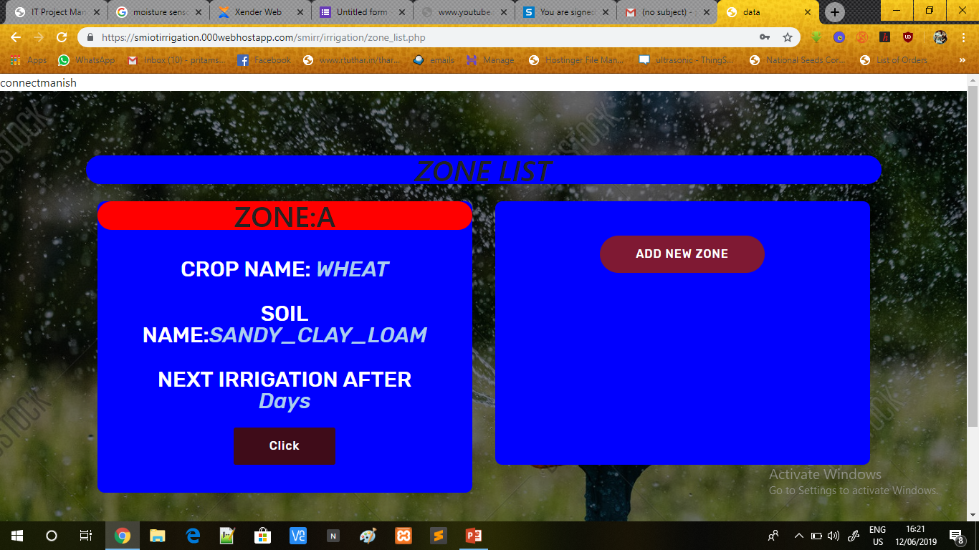
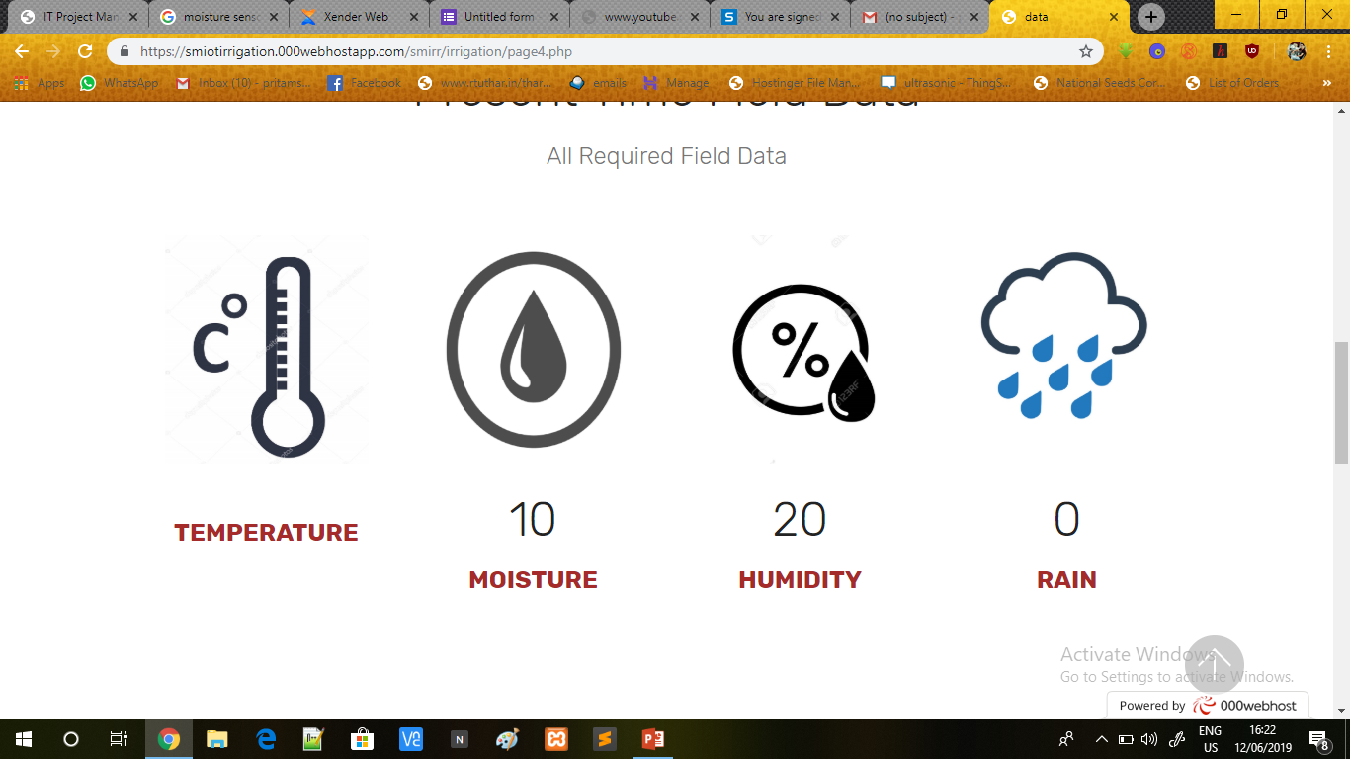

Slide 8
MARKET
Prospective Customers-
Farmers
Agricultural Researchers
Gardeners
Commercial farms
Flower farms
FAO (FOOD AND AGRICULTURE ORGANISATION ) - 70 percent rural households still depend primarily on agriculture
Up to May 2018, 9.87 million farmers were registered on e-NAM platform.(www.ibef.org)

Slide 9
Competition-
Available product-
ET gauge (spectrum technologies)
Cropin
Fasal
How are we different-
ET gauge – this is mainly a research product. It measures the moisture value but does not predict the irrigation Time left. Where as our product predict irrigation time accurately
Cropin – cropin provide irrigation solution by manual feedback from farmers and geological data of particular location. Where as we predict with real time data from field.

Slide 10
MARKETING STRATEGY
GROUND LEVEL MARKETING
VILLAGE AMBASSADOR
DEMONSTRATIONS
How we reach out-
posters, newspapers, banners
Seed & pesticide shops
local Dhan-mandi
Radio and agriculture TV channel
Announcements on vehicle
DRAMA (NUKAD-NATAK)
PANCHAYAT
DOOR TO DOOR PROMOTION

Slide 11
Market channel
Company
Distributor
Local distributors
Service centre
Village ambassador
Farmers

Slide 12
FINANCIAL
REVENUE MODEL
Our product is a B2C model. Profit by sales will be the revenue of the product
Price of the product is 15000 INR per acre( 3 units per hectare) and the cost for one acre is 9000 INR
Manufacturing cost- 3000 INR approx.

Slide 13
VALUE STATEMENT
Fair idea about irrigation
Real time data of field
Better irrigation management
Crop mapping

Slide 14
TEAM
Name – BALMUKUND PANDEY
Branch – ECE 3rd year
Skill- iot, web designing
Name – Ishwar Singh Solanki
Branch – ME 3rd year
Skill- Embedded , web designing,
hardware
Name –Pankaj Sharma
Branch – CIVIL 3rd year
Skill- soil ,irrigation, public relations
Name – Pritam Sharma
Branch – ECE ,3rd year
Skill- iot, web-design, public relations
Name – Prakash panwar
BRANCH – P&I
SKILL- Hardware, Marketing,
content writing
Name – sai chaithrika
BRANCH – EEE , 1st year
SKILL- content writing & marketing
Name – sai sreeja reddy
BRANCH – EEE , 1st year
SKILL- content writing & marketing ,translator
Name – vivek rajotia
BRANCH – EIC , 3rd year
SKILL-Embedded ,hardware

